Slide 1
Watch Recomender
DISPRO2 – FS24
Teresa Windlin, Luka Bozovic

Slide 2
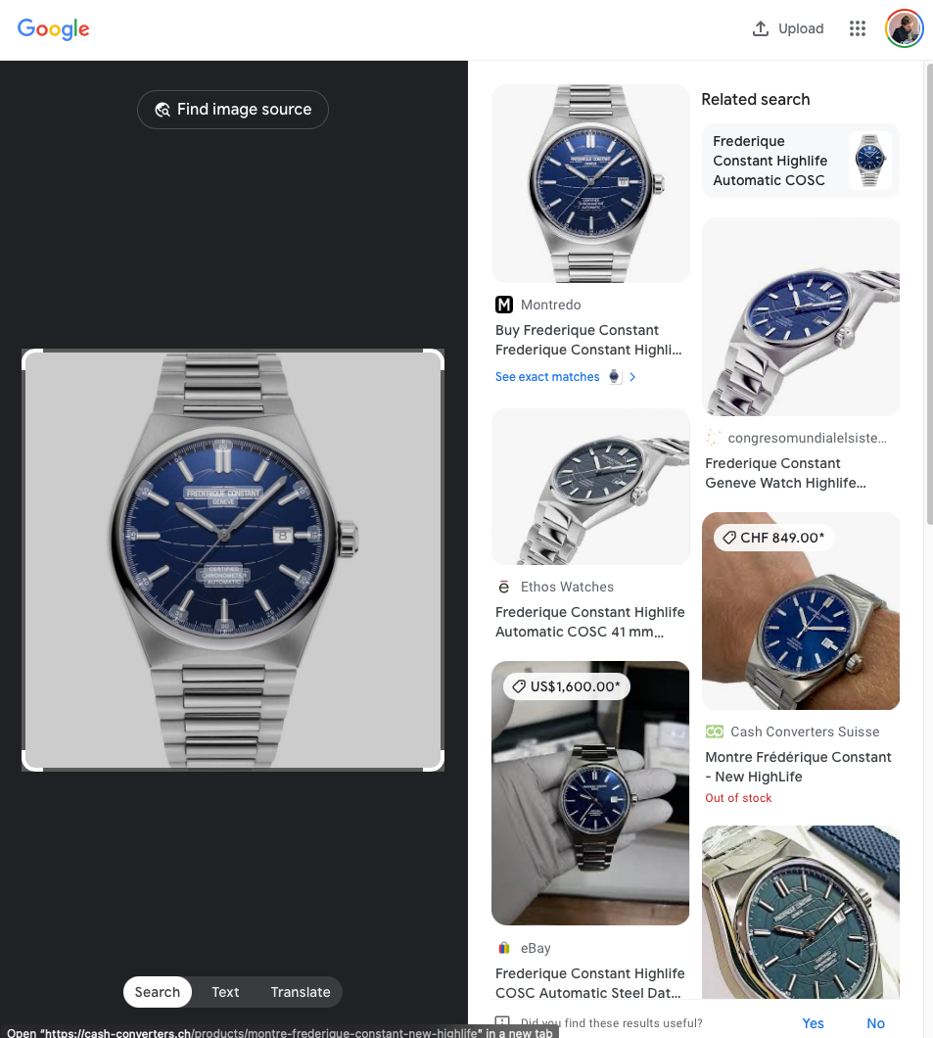
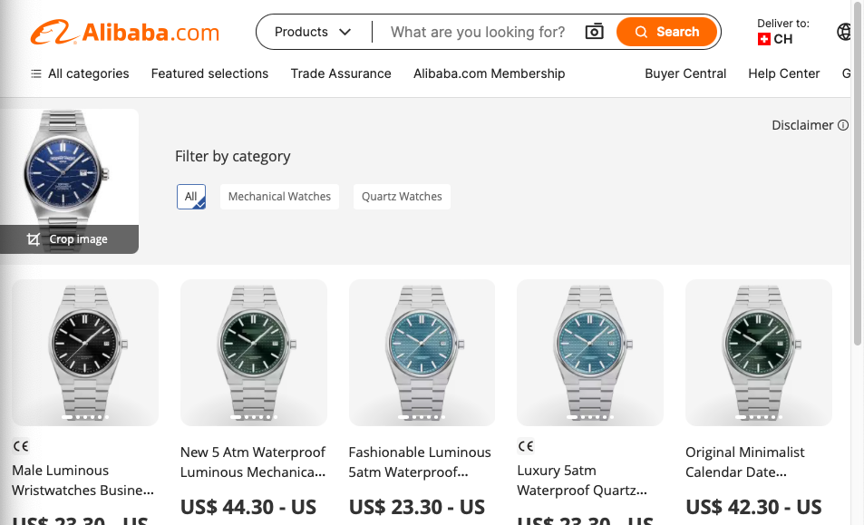
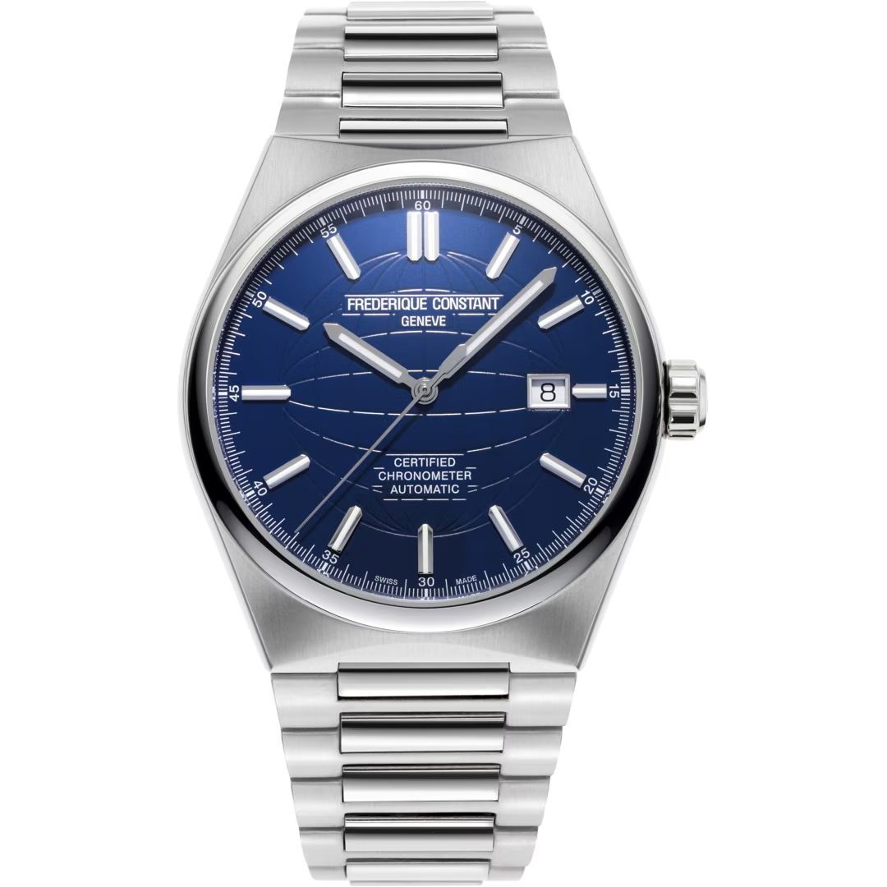
User story
Person: she, working but not huge salary, french
(like luka) found one liked watch, wants to find more
Uses tools like Google Lense, didn’t satisfy as just ‘zu verwechseln similar watches’ found, not watches she likes
Show use of webiste

Slide 3
User story
Gets more into watches,
W. engineering background fascinated by the movements,
→ filter on website
Unfortunely most mechanical watches bulky, catered for larger wrists
→ filter on website
Finds out about sapphire glass
→ filter on website
Struggles with high prices of wellknown brands, some unknown brands (microbrands) more reasonable
Finds them on a reddit forum but this search very time intensive.
→ idea behind algorithm: to recommend watch must be in our dataset, but no need to retrain model to recommend watch

Slide 4
Dataset
10’000 watches, 100 brands, 300 models (bring example of model)
What in json.
Distribution

Slide 5
Hypothesis style
Recap what we want: based on a watch a user liked, find another watch a user would wear.
Assumption on what user likes:
user likes one visual aspect of a watch (e.g. ziffern) (use example) ← mention here or later on?
Assumption on underlying design:
One brand has an overall design language (e.g. history in pilot, hence always easily read time) ← find better example
Analogy: artist and painting
Bit more complex as different designers, models (added strong dropout in NN, more to that later)
This actually Inspiration for project, in US NN trained to predict if user will like painting (only difference this project trained on explicit user feedback, vs we only evaluate on explicit user feedback)

Slide 6
Approach Training (NOT SURE HOW, MUST ADD VIZ gem Aygul)
Underlying design:
Can see this in image, hence start with CNN
Add parameters once final
Then retrain last 2 layers with contrastive learning,
Bring embeddings of same brand closer together
Add parameters once final

Slide 7
Training results (WandB)

Slide 8
Approach recommendation
Have embedding,
Use KNN
6 neibrous
Manual requrements:
don’t recommend the same wathc (distance 0)
evt shouldn’t look the same?
& don’t recommend more than 2 watches of the same brand
This is what we train on, but don’t want to overrepresent the same brand

Slide 9
Cost of training
Show WandB
Reiterate not nessesary to retrain to recommend a new watch, but must be in db

Slide 10
User interface (Describe (with user story) or let use themselves?)
First filters (size, movement, glass)
Dropdown of existing DB or a Random
Recommend watch
Recomemnded watches:
see image,
watch brand, model & model name (can copy)
Thumbs up/thumbs down (used vor validation)

Slide 11
Validation
Thumbs up / thumbs down, saved on cloud as google firbase.
Show cloud
Show results (x many people asked, on avg x of 6 results resonate with user

Slide 12
Try out ourself
Interactive validation? (very risky but very confident) alternative let try out after showing prepped validation
Strategy to avoid bias & difference btwn entheusiasts & beginner users:
Self-prompt: could I imagine person wearing input watch also wearing output watch?

Slide 13
Abstraction
Nessesary info for training: Brand & Image of watch.
Very little info.
Could abstract to other topics?

